Slide 1

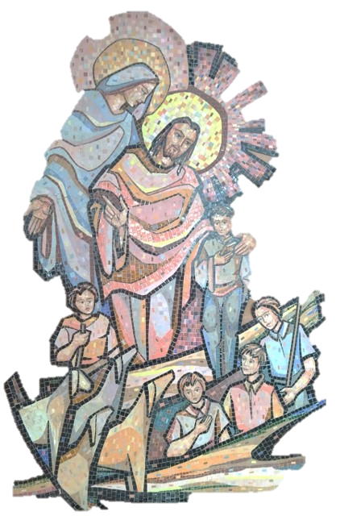
For the Salesian Family
The dream that makes you dream!
A heart that transforms 'wolves' into 'lambs'
Strenna 2024

Slide 2
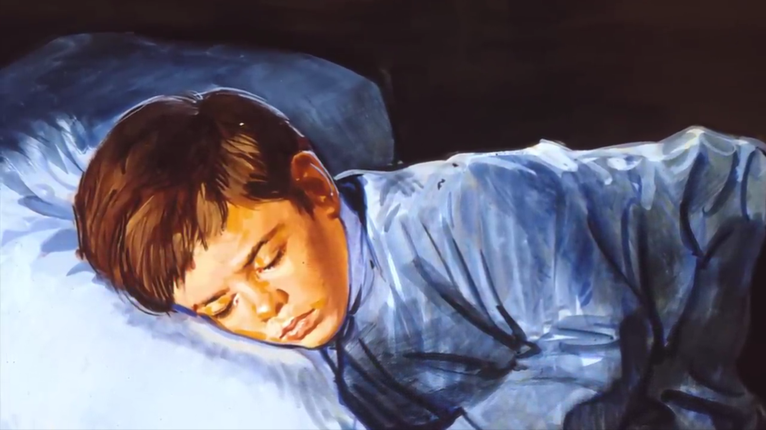
Contents
Introduction: Dreamers Today
Vocabulary
What is a Strenna?
Strenna 2024
Posters of Strenna 2024
Why this topic?
The Account of the Dream
Implications of Strenna 2024.
The Dream: Then and Now
Some Questions for SF on Strenna 2024

Slide 3
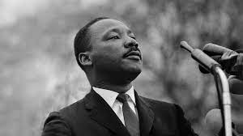
1. Dreamer of 20th Cent. “I have a dream.”
“…I have a dream that one day this nation will rise up and live out the true meaning of its creed: 'We hold these truths to be self-evident, that all men are created equal.
I have a dream that one day on the red hills of Georgia, the sons of former slaves and the sons of former slave owners will be able to sit down together at the table of brotherhood…
I have a dream that my four little children will one day live in a nation where they will not be judged by the colour of their skin but by the content of their character.
I have a dream today!“ (Martin Luther King Jr, on 28 August 1963)

Slide 4
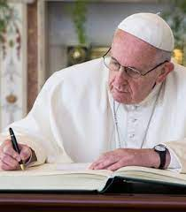
1.Dreamer of 21st Cent. “I dream a Missionary Church.”
I dream of a “missionary option”, that is, a missionary impulse capable of transforming everything, so that the Church’s customs, ways of doing things, times and schedules, language and structures can be suitably channeled for the evangelization of today’s world rather than for her self-preservation. The renewal of structures demanded by pastoral conversion can only be understood in this light: as part of an effort to make them more mission-oriented, to make ordinary pastoral activity on every level more inclusive and open, to inspire in pastoral workers a constant desire to go forth and in this way to elicit a positive response from all those whom Jesus summons to friendship with himself. (Evangelii Gaudium, 27)

Slide 5
2. Clarifying Notions: Vocabulary
Salesian→ Originating from St. Francis de Sales
Religious/Consecrated people → Fathers or sisters who live with vows, in communities for a specific mission designed by their founder/foundress.
Charism → Way of life for a specific style (for Religious)
Spirituality → Almost like charism. A way of life for anyone.
Province → Similar to Diocese. This is governing structure of Religious. Province is divided into communities exactly like dioceses to parishes.
Apostolate → Mission of Apostles (12+ apostles ). Carrying out the work of apostles in today’s context.
Preventive System→ Educative system designed by Don Bosco based on Reason, Religion and Loving Kindness. It is founded on the spirituality of St. Francis de Sales, in the style of Good Shepherd, articulated by DB.
Laity → Baptised members of the Catholic Church. They are neither clergy (ordained) nor religious.

Slide 6

3. Meaning and Origin of Strenna
Strenna = Gift. New Year Gift
A gift to the Salesian Family from the Rector Major, the head of the Salesian Family.

Slide 7
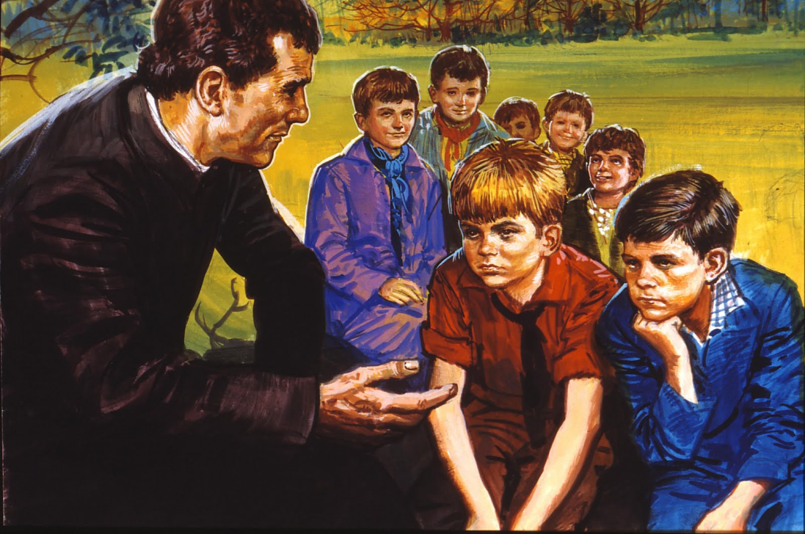
3. Meaning and Origin of Strenna
Started by Don Bosco as word in the ear
Exhortations for the year.
For unity of the Salesian Family, a unifying factor among Salesian Family.

Slide 8
4. Strenna 2024
The Source of all dreams of DB
Our dreams! Based on his dream.
The dream that makes you dream"
A heart that transforms 'wolves' into 'lambs'
The goal of the dream and our dreams!

Slide 9
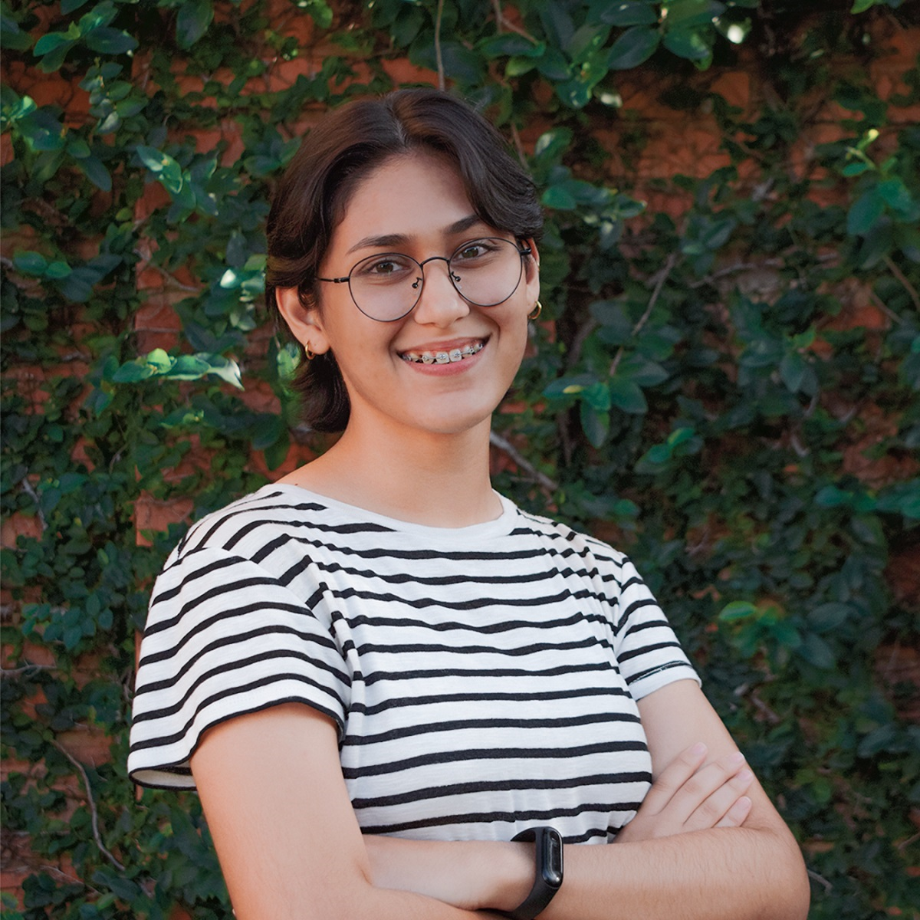
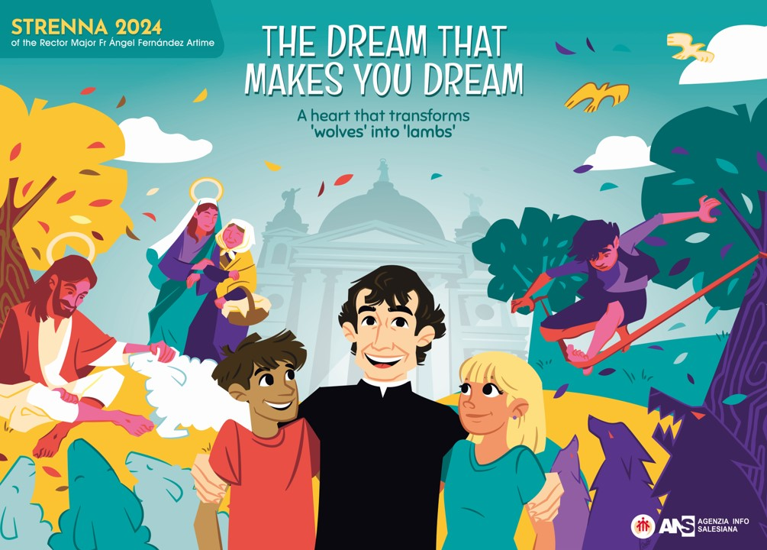
Artist: Salmi Medina, Paraguay
Cheerful Company
Lambs and Wolves

Slide 10

It is basically Salesianism in a drawing; Don Bosco with his young people, among whom the Saint always felt fulfilled. It reminds me a lot of the 'Salesians of Don Bosco' logo, where you see Don Bosco and the Salesians, travelling to accompany the young people around the world. Similar to that, this illustration represents that very journey and a way that he dreamt of for young people... hope'.
Salmi, Communication Student, Paraguay

Slide 11
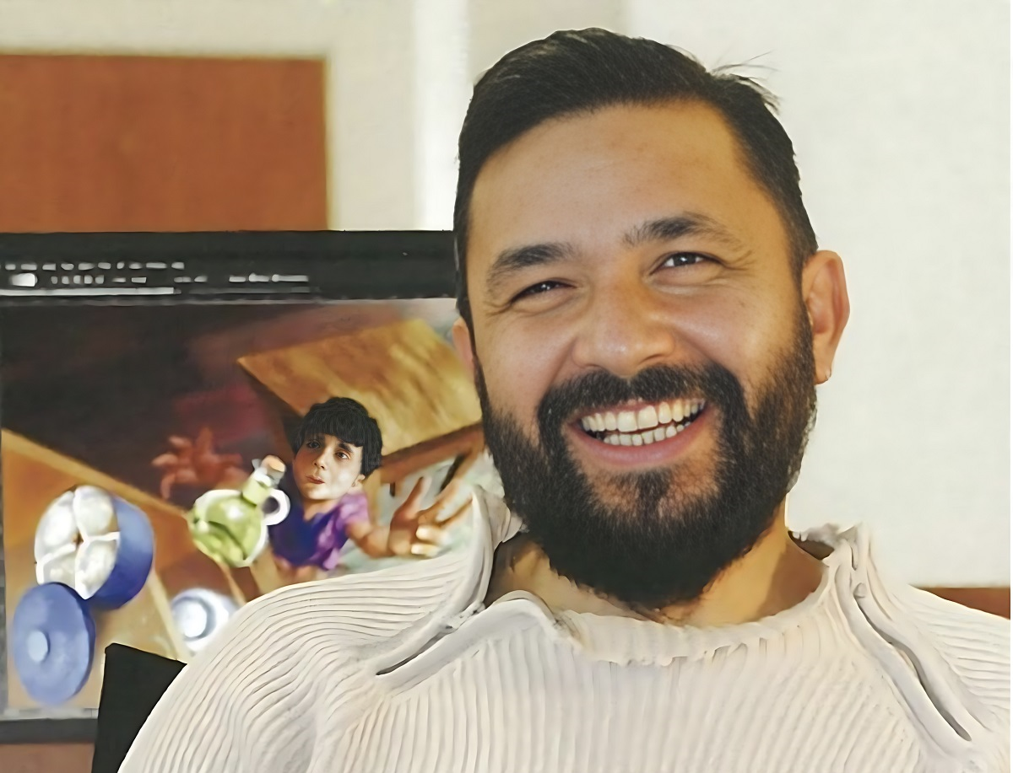
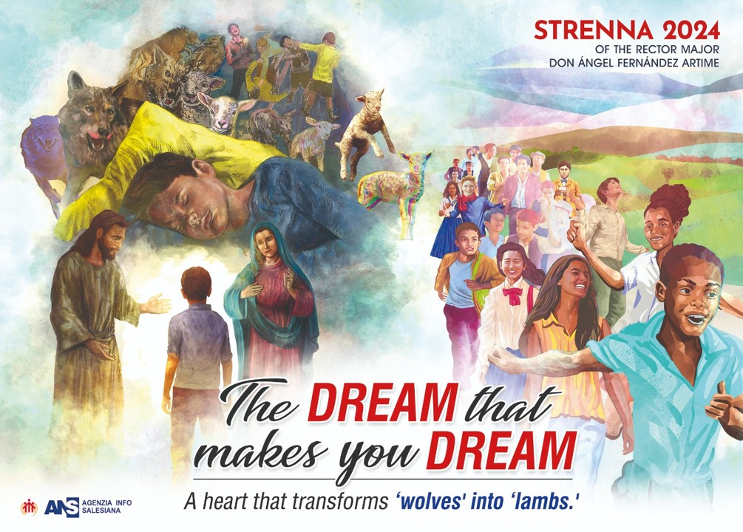
Artist: Nuno Quaresma, Portuguese, Member of Social Communications
Scene 1: The Dream
Scene 2: Instruction from Jesus and Mary
Scene 3: The Transformation

Slide 12
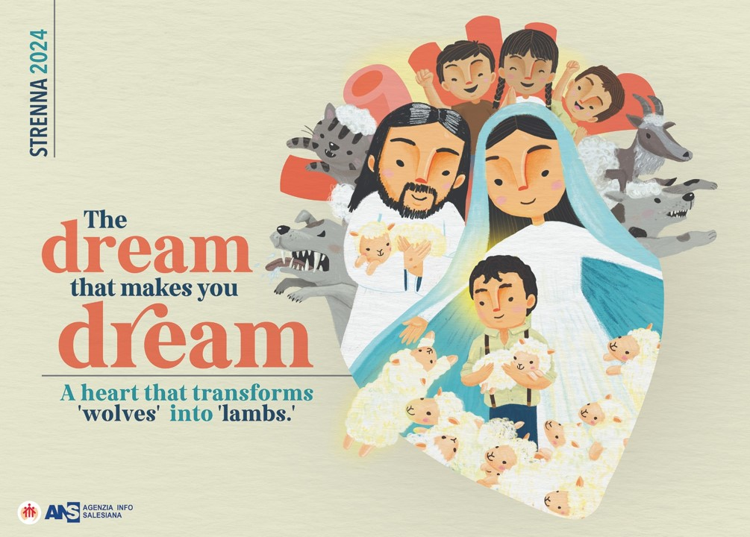
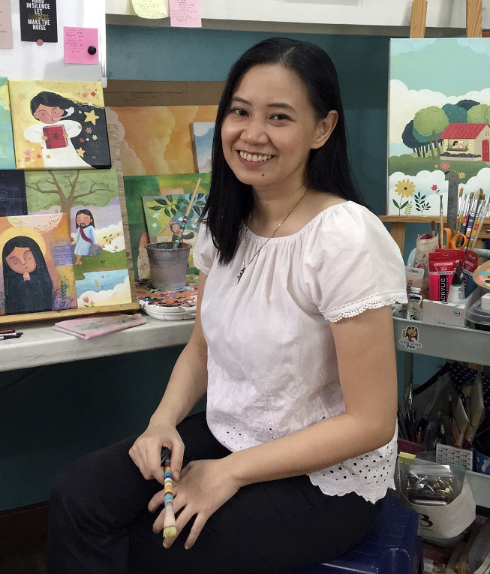
Artist: Reg Silva, Philippines, Lay student at Don Bosco School of Pastoral Theology
Within the Heart of God, that changes wolves into lamps.
Jesus the Good Shepherd; Johnny as a good shepherd
Jesus and Mary as protecting & guiding figures

Slide 13
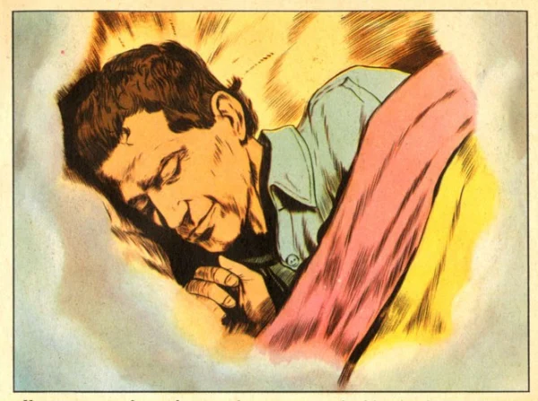
6. Why this topic?
2024 is the 200th anniversary of the dream of DB at 9.
The dream of all his dreams.
This dream shaped his life and mission.

Slide 14

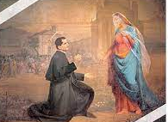
7. The Account of the Dream
There are several accounts of this dream.
The dream at 9 was written down by DB himself in the Memoirs of the Oratory (1873-1875).
Here DB narrates this dream to Don Barberis in 1875 (DB 60 years old)
Already founded SDB(1859), ADMA (1869), FMA (1872) and later ASC (1876)

Slide 15
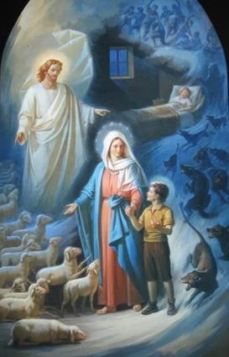
8. Implications of the Strenna 2024
DB’s entrustment to providence: “In Good times, you will understand everything.”
Continuous openness to the Word of God:
Modern Wolves we need to face: Indifference, ethical relativism, consumerism. (Fr. Pascual Chavez)
Towards a culture of loving kindness in the world of violence of hate: “Not with blows.”
Mother and Teacher to DB: “Look, learn and be patient!”

Slide 16
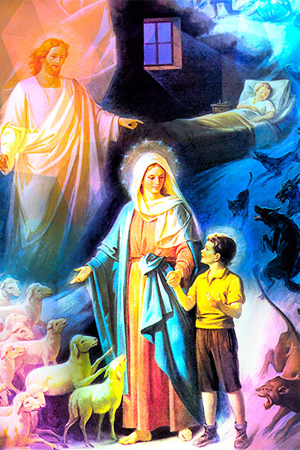
8. Implications of Strenna 2024
God has a dream for each of us. Challenge to match God’s dream for us and our dreams.
Choosing, dreaming and deciding are tough acts in life.
His dream helps us who we are and for whom we are.
We accompany the young people to explore their dreams.

Slide 17
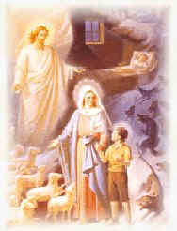
8. Implications of the Dream
Oratorian Mission in the Dream: A scene of full of youngsters!
The call to be a shepherd: tough job!
The Maternal Mediation of the Lady: A mother who taught about this Mother to remember her three times a day.
The Power of Meekness and Docility: “Strong, humbler and energetic.”

Slide 18
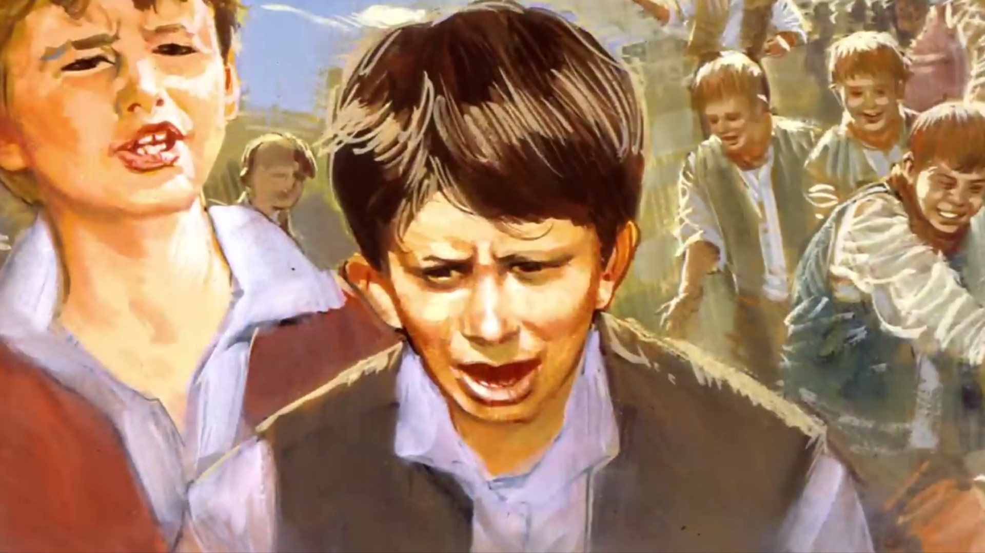
9. His Dream Then and Now
Scene 1: The Fight
Now: The World of violence: Israel-Gaza War, Russia- Ukraine War, Manipur,….
Culture of death and hate today.

Slide 19
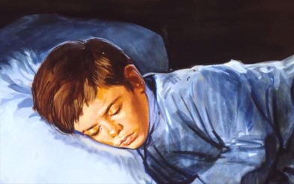
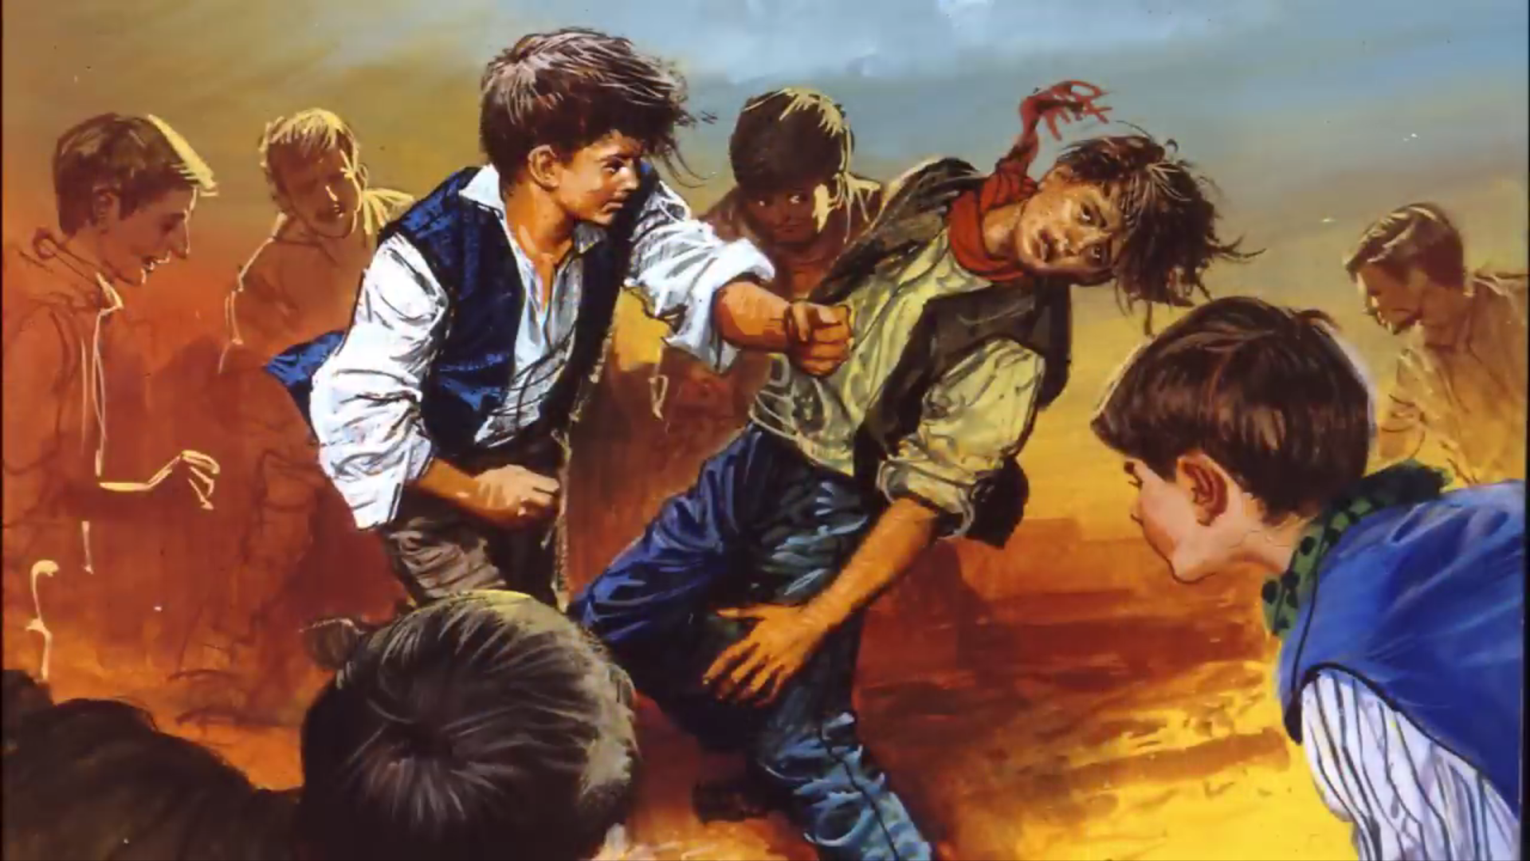
9. His Dream Then and Now
Scene 2: The Reaction
Johnny fights with them.
Now: Eye for an Eye… The law of retaliation

Slide 20
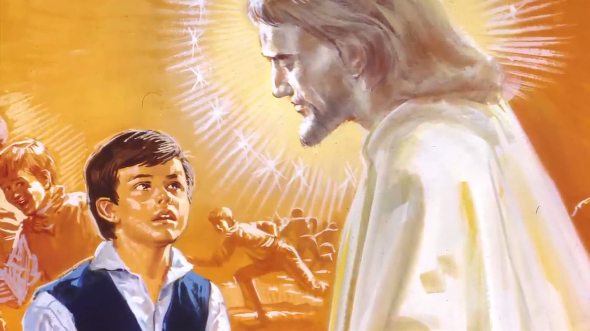
9. His Dream Then and Now
Scene 3: The Response
“Not With blows… Preventive System, Sign and bearer of God’s love. ‘Facing the wolves.’ (Fr. Pascual Chavez)
Now: Positive Pedagogy, Proactive instead of Reactive., Generating a positive Environment

Slide 21
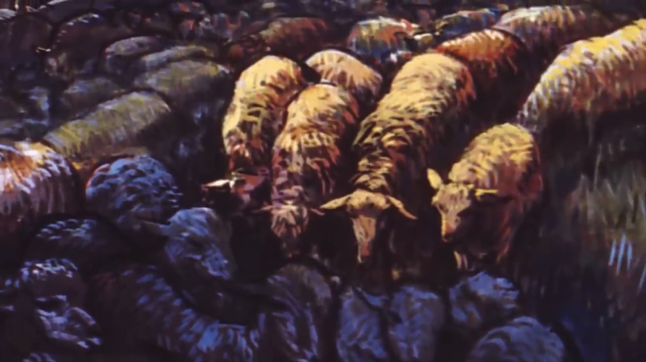
9. His Dream Then and Now
Scene 4: The Transformation
Wolves to lambs. ‘Good Christians & Honest citizens.’
Now: What’s the mission of our mission? Why do we do what we do?

Slide 22
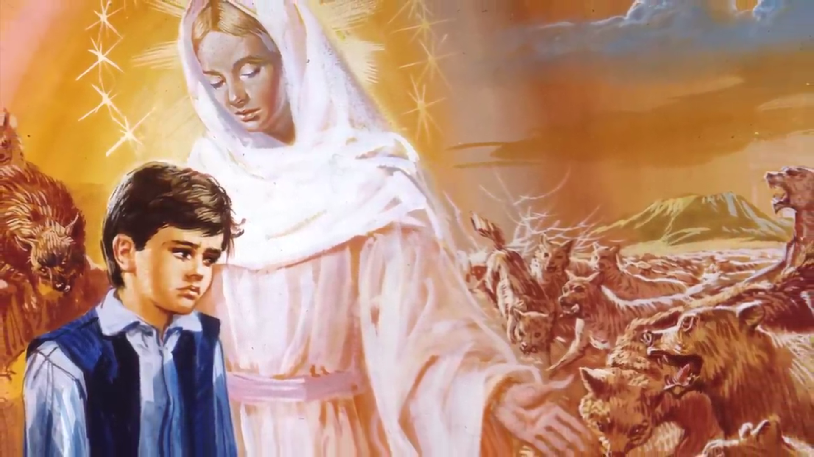
9. His Dream Then and Now
Scene 5: The Teacher/ helper/mother
The Marian Dimension
“Make yourself humble, strong and energetic.”
“Look, learn and be patient!”
Now: Merely a devotion or vocation?
What do we learn from her?

Slide 23
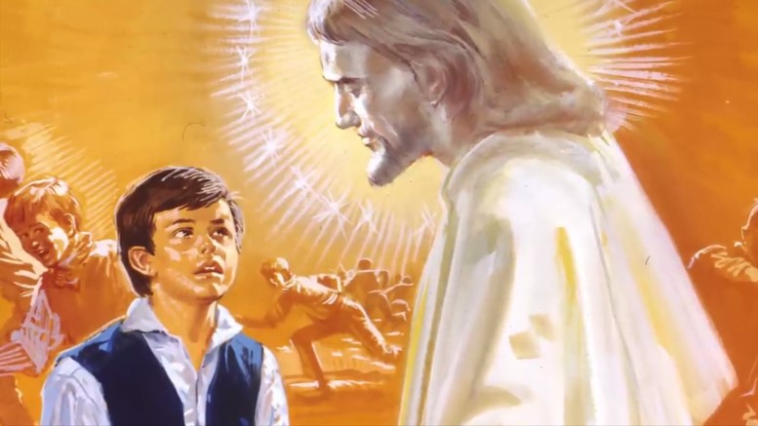
9. His Dream Then and Now
Scene 6: The Inspiration
Jesus the Good Shepherd
“Teach ugliness of sin and value of virtue.”
Now: Want of good leaders/pastors in church and society.
What do we teach in life?

Slide 24
10. Some Questions for Salesian Family on Strenna 2024
What are some of the relevant dimensions of this dream in today’s society and Church?
What is the significance of this dream for the Salesian Family/ Salesian family branches in today’s context?
Propose some concrete ideas to implement this Strenna in 2024 in communities/units of Salesian Family?
What are your dreams as a Salesian/Salesian family Member today? Write a personal reflection on your dreams in line with the young, preventive system, Jesus the good shepherd and Marian Dimension.

Slide 25


That’s all Folks!
“In every young, even the most wretched there is a soft spot.” (Don Bosco)
Based on the Letter of the Rector Major, Card. Ángel Fernández Artime, S.D.B.
Prepared by Fr. Gilbert Choondal SDB, Delegate of the Salesian Family, INK

